Slide 1



Group - DatAlchemy Final Project Presentation Airline Passenger Satisfaction
Group members:
Uday Kiran Galla Srinivasalu
Chandana Bhat Thambrahalli
DSC 465 - Data Visualization DePaul University Prof. Jodi Hill 6.3.2024
Naveen Kumar Reddy Veeramreddy
Mai Phuong Tran Ngo
Guntaka Satish Harshavardhan Reddy

Slide 2





Agenda
Data
Data
Data
Data
Data
Story/Message
Conclusion
Recommendation
Q&A
2

Slide 3






Source: Kaggle - Airline Passenger Satisfaction
Data
Dimension
Rows: 129,880
Columns: 24
Numerical
ID
Age
Flight Distance
Departure Delay
Arrival Delay
Categorical
Gender
Customer Type
Type of Travel
Class
Satisfaction Status
Ordinal
14 survey questions.
1 (lowest) to 5 (highest)
0 (N/A)
Objective
Identify areas for improvement in airline services to enhance passenger satisfaction.
3
Notes:
Specifically, we are focusing on two approaches…
Our visualizations will emphasize based on these two attributes.
With this being said, to begin with we want to get snapshot of the passenger demographic of this data.

Slide 4
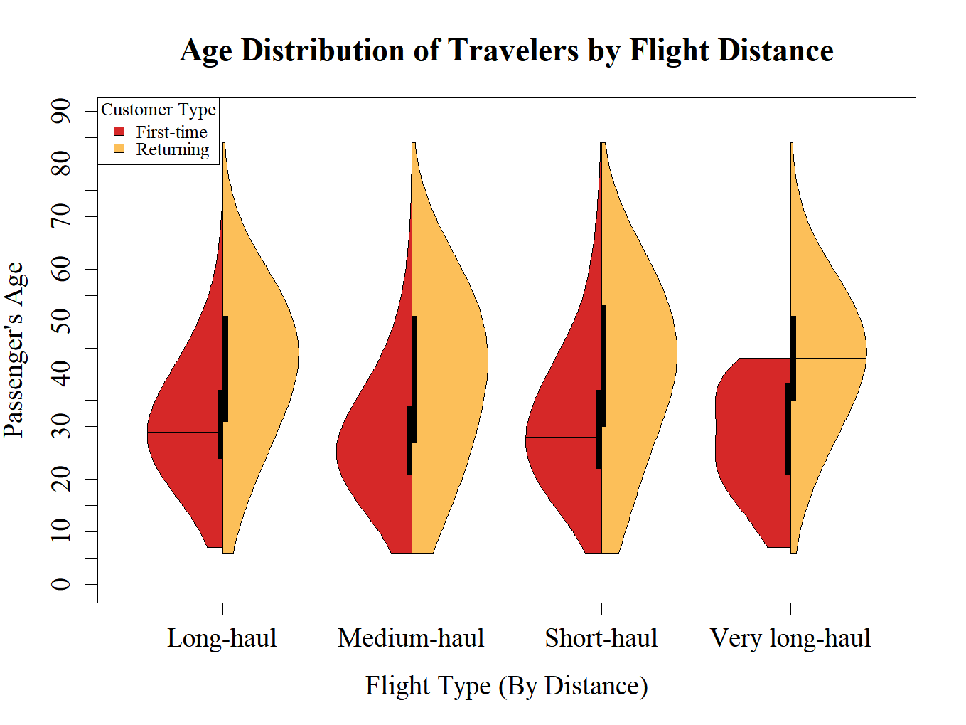

4
Short haul (< 500mi)
Medium haul (< 1500mi)
Long haul (< 3000mi)
V. Long haul (> 3000mi)

Slide 5
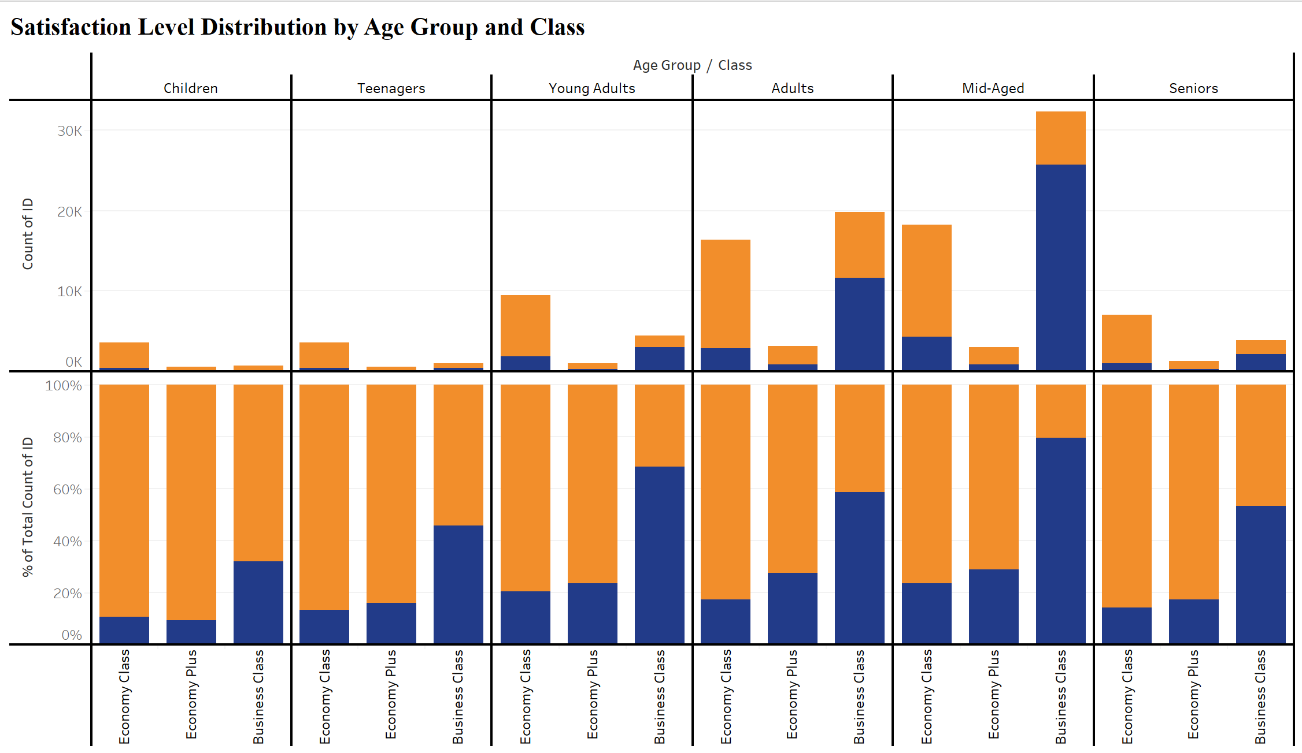
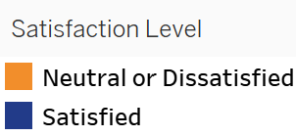


Young Adults: < 24
Adults: 25 - 39
Mid-Aged: 40 – 59
Seniors: > 59
5
Notes:
Top: number of passengers distributed across each sub-group with respect to the entire dataset..
Mid-Aged flying business class most (32k)
Down: Satisfaction level distribution within each subgroup. – Business more satisfied.
Passengers needs to pay a slight premium for the upgrade.
With this, we look further into satisfaction responses by flight classes.

Slide 6
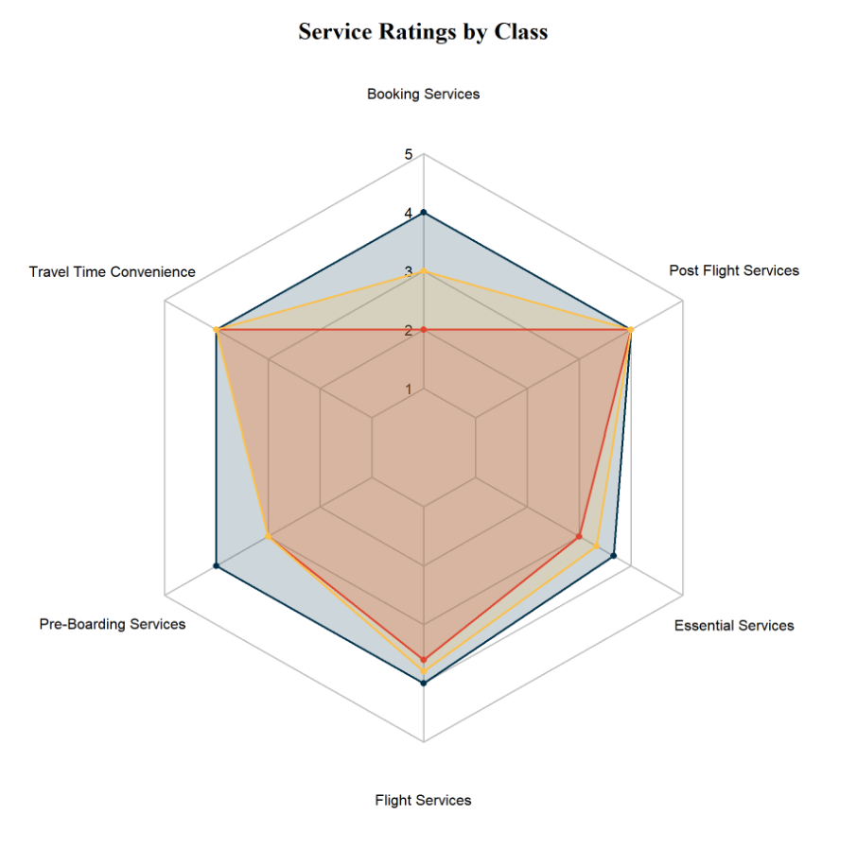
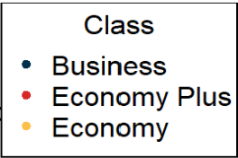


Over 60% of passengers travel in Economy and Economy plus
6

Slide 7
Over 60% of passengers travel in Economy and Economy plus
6

Slide 8
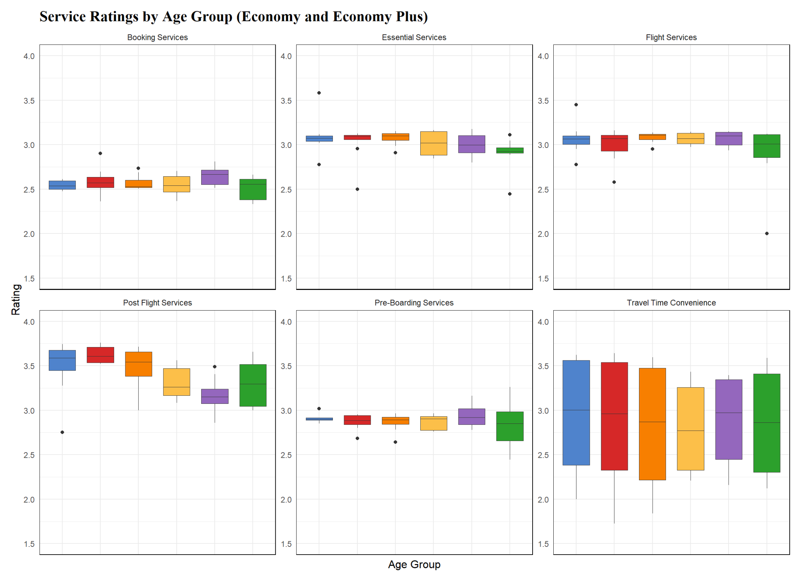
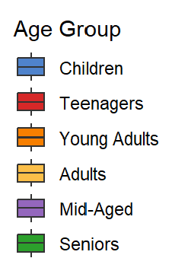
7

Slide 9
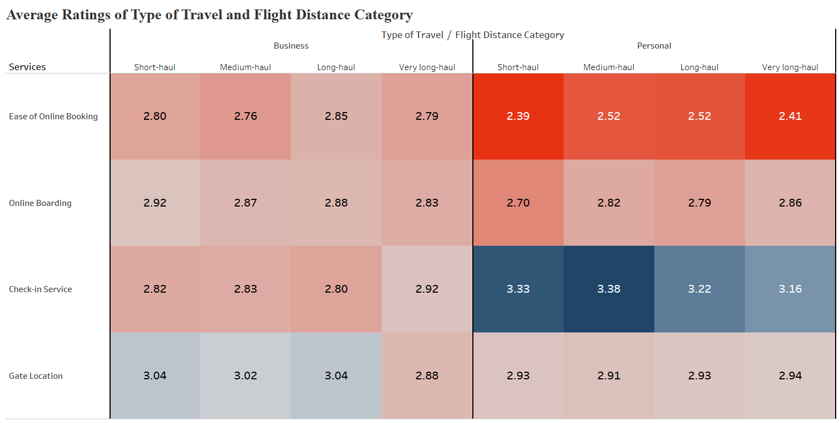
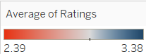
8

Slide 10


Conclusion
Recommendation
Most airline passengers are Adults and Mid-Aged (25-59 years old).
Passengers are generally more satisfied flying Business class.
Passengers from Economy and Economy Plus classes have rated lesser compared to Business class for various service categories.
Booking and Pre-Boarding have least median ratings among all the service categories (< 3.0).
Objective: Identify areas for improvement in airline services to enhance passenger satisfaction.
For Economy and Economy Plus classes, develop improvement plan for Booking and Pre-Boarding services.
Specifically, convenience in booking online. Working with third-party ticket vendor or other airlines.
Improve Check-in service for Business class.
8

Slide 11

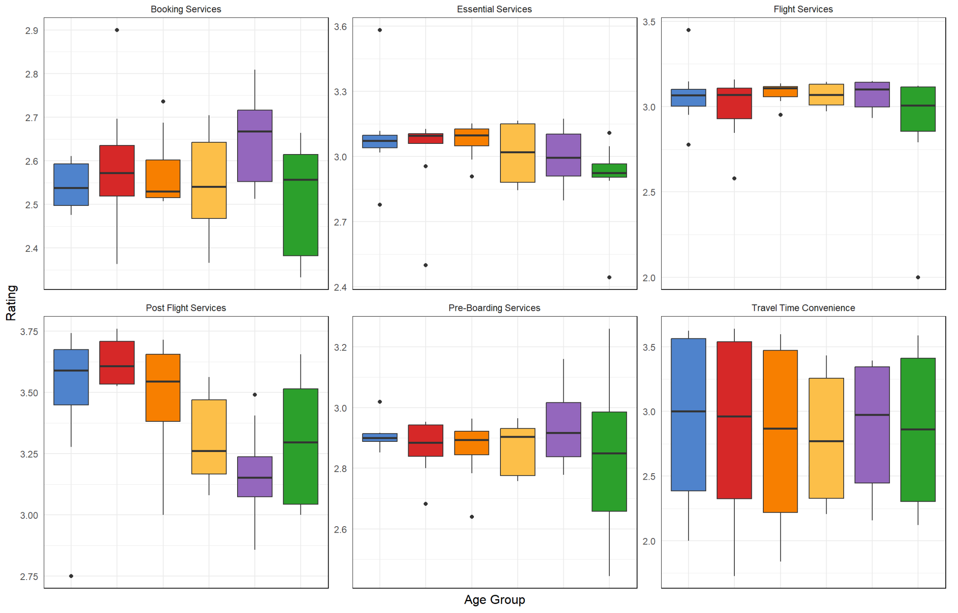
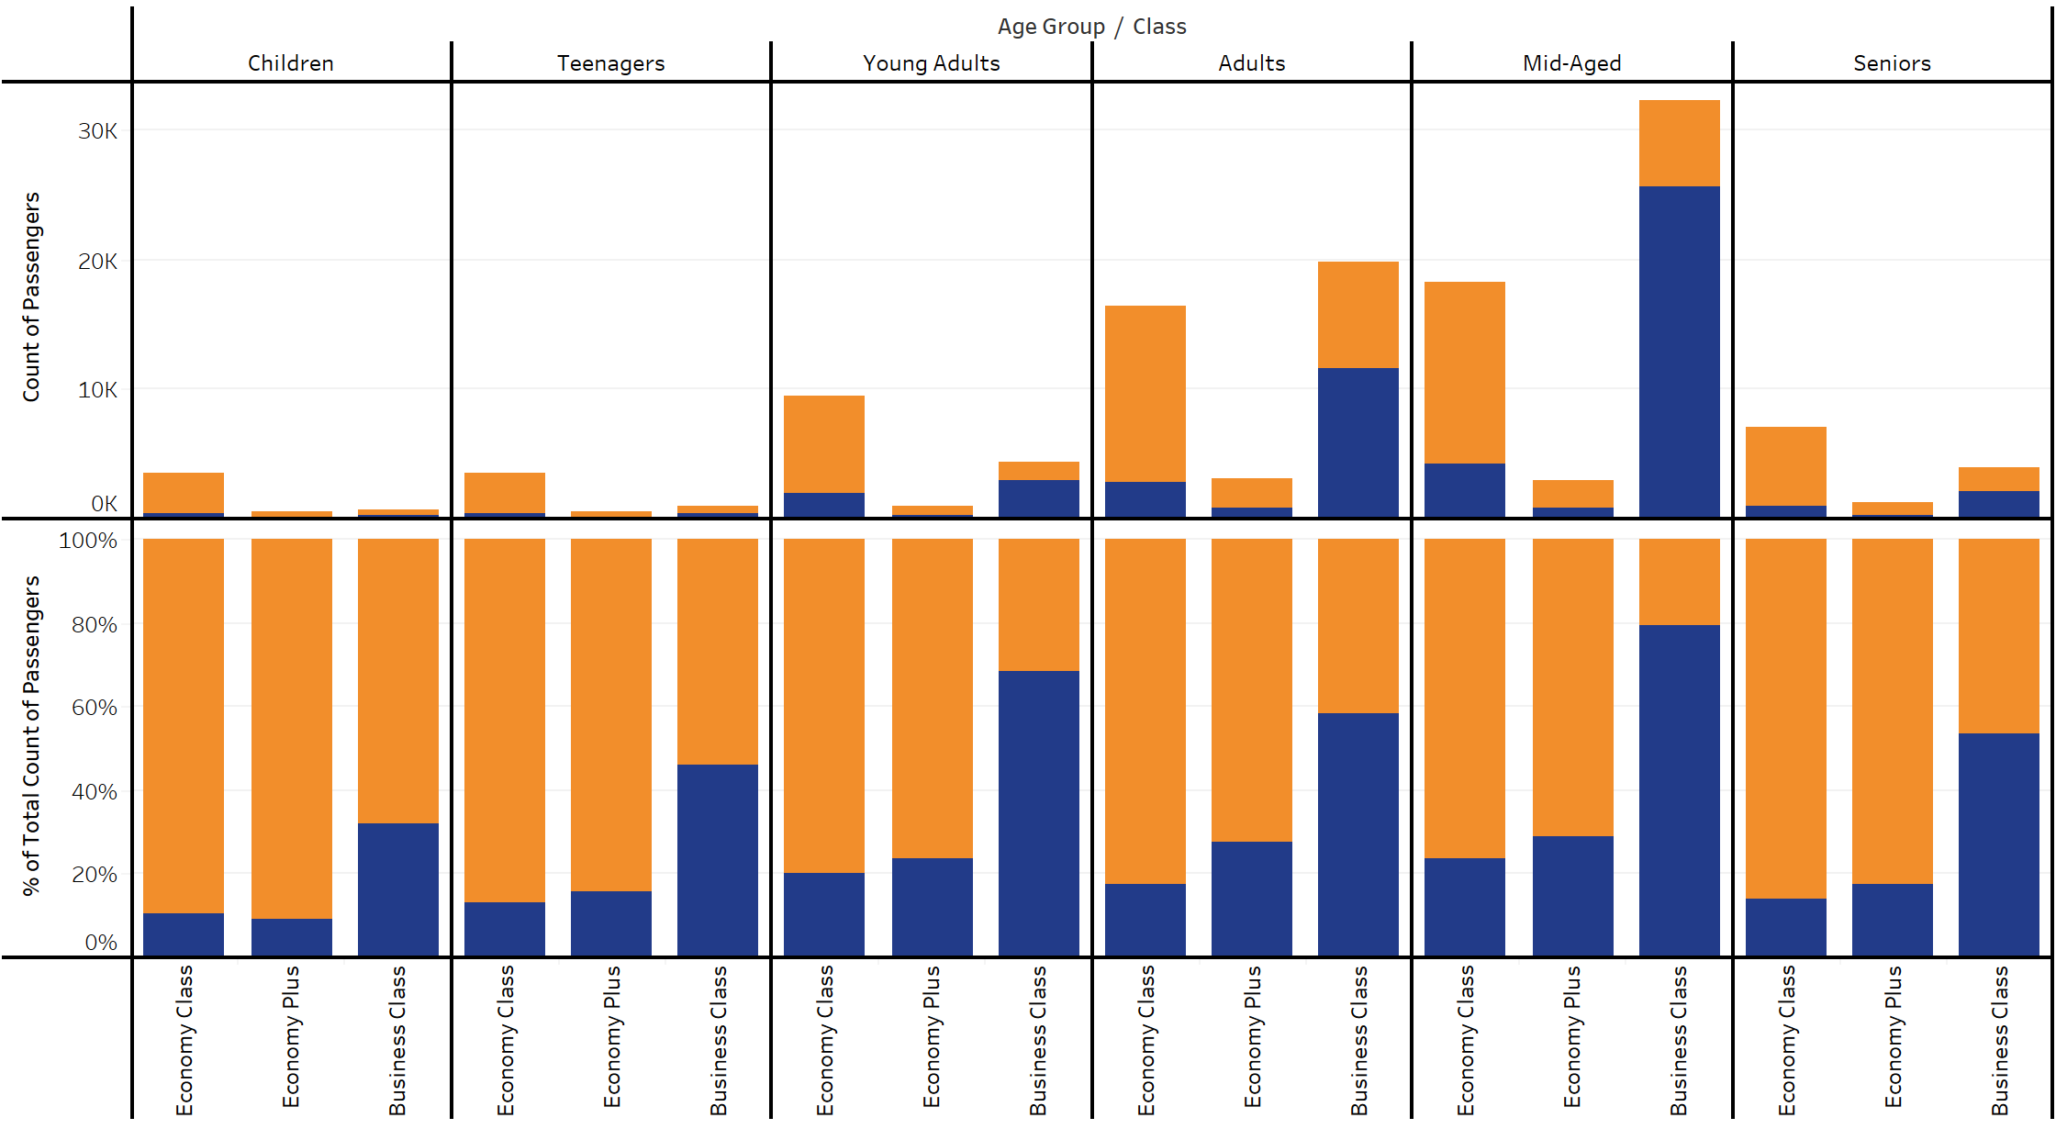
Q & A

Slide 12

THANK YOU!!

